Slide 1


vPIM: Efficient Virtual Address Translation for Scalable Processing-in-Memory Architectures
Amel Fatima, Sihang Liu, Korakit Seemakhupt, Rachata Ausavarungnirun, Samira Khan
Notes:
Hi Everyone, I am Amel Fatima and today I am going to talk about our work on “vPIM: An efficient address translation mechanism for PIM architectures”

Slide 2
Summary
Multiple PIM stacks provide increase capacity for emerging data-intensive workloads
Problem: Address translation incurs significant overhead in accessing multiple PIM stacks
Radix-based translation: Multiple sequential cross-stack page table walks
Cuckoo hash-based translation: Multiple parallel accesses across memory stacks
Goal: Design an efficient address translation scheme for multi-stack PIM systems
Observations and Key Ideas:
Observation: High intra-stack parallelism with multiple vaults in each stack
Key Idea: Network-contention-aware hash
Change cuckoo hash layout to generate parallel accesses within one stack across multiple vaults
Send only one request towards the stack and generate parallel accesses within the stack
Observation: High parallelism enables minimal performance loss with fewer cores
Key Idea: Pre-translate addresses
Use a few cores to run ahead future iterations of the workload
Pre-translate cross-stack addresses and bring them inside the same stack for future use
Result: vPIM provide 4.4x and 1.7x speedup compared to radix and cuckoo hash
Notes:
I WILL start by briefly summarizing our work. Processing in memory PIM is a new technology that brings computation closer to the memory. To further satisfy the demand of data intensive applications multiple PIM stacks are connected over a memory network to scale the capacity. Performing address translation in such multi-stack pIM systems incur additional overhead as a result of making multiple cross stack accesses over the network. For example in a radix based translation, we make multiple sequential cross stack accesses to retrieve the translation whereas in a recently proposed cuckoo hash based transaltion we make parallel accesses across the network. So in this work, our goal is to design an efficient address translation scheme for such multi-stacked PIM systems. To achieve our goal, we make a few observations and based on those we propose our two main key ideas. Our first observation is the presence of high intra stack parallelism with multiple vaults within each stack. BASED ON that, we propose our network contention aware hash which spawns parallel accesses within a stack by sending only one request across the network. Our second observation of high core parallelism which enables minimal performance loss with fewer cores leads to our second key idea of pretranslation. This involves dedicating some cores in a stack to run ahead future iterations of the workloads. By running future iterations we pre-translate page table walks and bring them inside the stack for future use. Our proposal achieves a 4.4 times 1.7 times speedup compared to radix and cuckoo hash.

Slide 3
Outline
Processing-in-Memory Introduction
Address Translation in PIM Architecture
Challenges and Key Ideas
Evaluation
Conclusion
Notes:
This is a brief outline of todays talk. I will st

Slide 4
Outline
Processing-in-Memory Introduction
Address Translation in PIM Architecture
Challenges and Key Ideas
Evaluation
Conclusion
Notes:
I will start by introducing processing-in-memory architecture.

Slide 5
Processing in Memory (PIM)
PIM is a new technology where computation is placed closer to the memory
Notes:
PIM is a new technology where

Slide 6
Processing in Memory (PIM)
PIM is a new technology where computation is placed closer to the memory
^{Multiple}
^{Memory Banks}
Vault 0
Vault 31
Vault 0
Vault 0
Vault 0
Vault 0
Notes:
computation *
is placed

Slide 7
Processing in Memory (PIM)
PIM is a new technology where computation is placed closer to the memory
PIM STACK
^{Multiple}
^{Memory Banks}
HOST CPU
PIM STACK
Vault 0
Vault 31
Vault 0
…
Vault Logic
Vault Logic
Core 0
Core 31
Vault 0
Vault 0
Vault 0
Vault Logic
Core 0
Notes:
closer to the memory * in order to reduce the data movement bottleneck in current systems.

Slide 8
Processing in Memory (PIM)
PIM is a new technology where computation is placed closer to the memory
Prior works used PIM to reduce data movement between CPU and memory
Tesseract[ISCA’15], Tetris[ASPLOS’17], TOM[ISCA’16], etc.
PIM STACK
^{Multiple}
^{Memory Banks}
HOST CPU
PIM STACK
Vault 0
Vault 31
Vault 0
…
Vault Logic
Vault Logic
Core 0
Core 31
Vault 0
Vault 0
Vault 0
Vault Logic
Core 0
Notes:
*There are several prior works that leverage PIM capability to enhance performance.

Slide 9
Processing in Memory (PIM)
PIM is a new technology where computation is placed closer to the memory
Prior works used PIM to reduce data movement between CPU and memory
Tesseract[ISCA’15], Tetris[ASPLOS’17], TOM[ISCA’16], etc.
PIM STACK
^{Multiple}
^{Memory Banks}
HOST CPU
PIM STACK
Vault 0
Vault 31
Vault 0
…
Vault Logic
Vault Logic
Core 0
Core 31
Vault 0
Vault 0
Vault 0
Vault Logic
Core 0
Placing computation closer to memory improves performance
Notes:
. *So placing computation closer to the memory improves performance.

Slide 10
Processing in Memory (PIM)
Data-intensive applications demand more memory
PIM STACK
^{Multiple}
^{Memory Banks}
Vault 0
Vault 31
Vault 0
…
Vault Logic
Vault Logic
Core 0
Core 31
Vault 0
Vault 0
Vault 0
Vault Logic
Core 0
Notes:
: Data-intensive applications demand more memory. To satisfy the demand of such emerging data intensive applications

Slide 11
Processing in Memory (PIM)
Data-intensive applications demand more memory
Multiple stacks are connected over a memory network to scale up to higher capacity
S0
S3
S8
S11
PIM STACK
^{Multiple}
^{Memory Banks}
S1
S2
S9
S10
Vault 0
Vault 31
Vault 0
…
Host CPU
Vault Logic
Vault Logic
Core 0
Core 31
Vault 0
S4
S7
S12
S15
Vault 0
S5
S6
S13
S14
Vault 0
Vault Logic
Core 0
Notes:
multiple PIM stacks are connected over a memory network to scale up to higher capacity.

Slide 12
Processing in Memory (PIM)
Data-intensive applications demand more memory
Multiple stacks are connected over a memory network to scale up to higher capacity
S0
S3
S8
S11
PIM STACK
^{Multiple}
^{Memory Banks}
S1
S2
S9
S10
Vault 0
Vault 31
Vault 0
…
Host CPU
Vault Logic
Vault Logic
Core 0
Core 31
Vault 0
S4
S7
S12
S15
Vault 0
S5
S6
S13
S14
Vault 0
Vault Logic
Core 0
A multi-stacked PIM system provides increased capacity
for emerging data-intensive applications
Notes:
A multi-stacked PIM system provides increased capacity for emerging data intensive applications

Slide 13
Outline
Processing-in-Memory Introduction
Address Translation in PIM Architecture
Challenges and Key Ideas
Evaluation
Conclusion
Notes:
Now I will talk about address translation in such multi-stacked PIM architectures

Slide 14
Memory Management in PIM
Access from CPU Host
S0
S3
S8
S11
PIM STACK
^{Multiple}
^{Memory Banks}
S1
S2
S9
S10
Vault 0
Vault 31
Vault 0
…
Host CPU
Vault Logic
Vault Logic
Core 0
Core 31
Vault 0
S4
S7
S12
S15
Vault 0
S5
S6
S13
S14
Vault 0
Vault Logic
Core 0
Notes:
The execution of an application is divided between the CPU and PIM cores

Slide 15
Memory Management in PIM
Both CPU and PIM cores are accessing the same memory
Access from CPU Host
S0
S3
S8
S11
PIM STACK
^{Multiple}
^{Memory Banks}
S1
S2
S9
S10
Vault 0
Vault 31
Access from PIM cores
Vault 0
…
Host CPU
Vault Logic
Vault Logic
Core 0
Core 31
Vault 0
S4
S7
S12
S15
Vault 0
S5
S6
S13
S14
Vault 0
Vault Logic
Core 0
Notes:
and thus Both CPU and PIM cores access the same memory *

Slide 16
Memory Management in PIM
Both CPU and PIM cores are accessing the same memory
Access from CPU Host
S0
S3
S8
S11
PIM STACK
^{Multiple}
^{Memory Banks}
S1
S2
S9
S10
Vault 0
Vault 31
Access from PIM cores
Vault 0
…
Host CPU
Vault Logic
Vault Logic
Core 0
Core 31
Vault 0
S4
S7
S12
S15
Vault 0
S5
S6
S13
S14
Vault 0
Vault Logic
Core 0
PIM provides an opportunity for a unified virtual address space
Notes:
This setting provides an opportunity for a unified virtual address space between the CPU and PIM cores

Slide 17
Address Translation
Notes:
.

Slide 18
Address Translation
Unified virtual memory requires translating virtual addresses to physical addresses
^{Virtual Address}
^{Translation}
^{Physical Address}
Notes:
* A unified virtual memory requires translating virtual addresses to physical addresses * .

Slide 19
Address Translation
Unified virtual memory requires translating virtual addresses to physical addresses
Address translation requires multiple accesses to the page table
^{Virtual Address}
^{Translation}
^{Physical Address}
Notes:
* This Address translation requires making multiple accesses to the page table

Slide 20
Address Translation
Unified virtual memory requires translating virtual addresses to physical addresses
Address translation requires multiple accesses to the page table
It introduces significant overhead in conventional systems which is even worse in PIM
^{Virtual Address}
^{Translation}
^{Physical Address}
Notes:
These accesses incurs significant overhead in a conventional system which is even worse in a PIM based system.

Slide 21
Address Translation
Unified virtual memory requires translating virtual addresses to physical addresses
Address translation requires multiple accesses to the page table
It introduces significant overhead in conventional systems which is even worse in PIM
There are two different commonly used approaches for address translation:
^{Virtual Address}
^{Translation}
^{Physical Address}
Notes:
* There are two commonly used approaches of translating virtual addresses in current systems:

Slide 22
Address Translation
Unified virtual memory requires translating virtual addresses to physical addresses
Address translation requires multiple accesses to the page table
It introduces significant overhead in conventional systems which is even worse in PIM
There are two different commonly used approaches for address translation:
Radix Page Table
^{Virtual Address}
^{Translation}
^{Physical Address}
Notes:
* Radix page table based approach
*

Slide 23
Address Translation
Unified virtual memory requires translating virtual addresses to physical addresses
Address translation requires multiple accesses to the page table
It introduces significant overhead in conventional systems which is even worse in PIM
There are two different commonly used approaches for address translation:
Radix Page Table
Hash Page Table
^{Virtual Address}
^{Translation}
^{Physical Address}
Notes:
Hash page table based approach

Slide 24
Address Translation
Unified virtual memory requires translating virtual addresses to physical addresses
Address translation requires multiple accesses to the page table
It introduces significant overhead in conventional systems which is even worse in PIM
There are two different commonly used approaches for address translation:
Radix Page Table
Hash Page Table
^{Virtual Address}
^{Translation}
^{Physical Address}
Both radix and hash page table introduce
significant overhead in multi-stacked PIM system
Notes:
Both radix and hash page table translation incur significant overhead in a PIM based system.
* Now I will discuss about these two mechanisms one by one and talk about their integration overhead in a PIM system.

Slide 25
Radix Based Address Translation
A virtual address is translated to a physical address by walking 4 levels of page table
^{Virtual Address}
^{Translation}
^{Physical Address}
Notes:
The first one is the radix based translation,

Slide 26
Radix Based Address Translation
A virtual address is translated to a physical address by walking 4 levels of page table
^{Virtual Address}
^{Translation}
^{Physical Address}
Notes:
In a radix based page table walk a virtual address is translated to a physical address

Slide 27
Radix Based Address Translation
A virtual address is translated to a physical address by walking 4 levels of page table
^{Virtual Address}
Virtual Address
47:39
38:30
29:21
20:12
^{Translation}
PPN
L4
L3
L2
L1
CR3
^{Physical Address}
Notes:
by making four sequential accesses to the page table

Slide 28
Radix Based Translation in PIM
Notes:
Now I will talk about integrating this radix page table walk in a PIM based system.

Slide 29
Radix Based Translation in PIM
Page Tables are distributed across the PIM stacks
S0
S3
S8
S11
S1
S2
S9
S10
Host CPU
S4
S7
S12
S15
S5
S6
S13
S14
Notes:
* In a PIM based system, radix page table is distributed across the PIM stacks. Therefore

Slide 30
Radix Based Translation in PIM
Page Tables are distributed across the PIM stacks
Each translation can require up to four accesses to different PIM stacks
Virtual Address
S0
S3
S8
S11
47:39
38:30
29:21
20:12
S1
S2
S9
S10
Host CPU
L4
S4
S7
S12
S15
CR3
S5
S6
S13
S14
TLB Miss at Stack 5
Notes:
. EACH TRANSLATION access may require making four sequential accesses to different PIM stacks. *

Slide 31
Radix Based Translation in PIM
Page Tables are distributed across the PIM stacks
Each translation can require up to four accesses to different PIM stacks
Virtual Address
S0
S3
S8
S11
47:39
38:30
29:21
20:12
S1
S2
S9
S10
Host CPU
L4
L3
S4
S7
S12
S15
CR3
S5
S6
S13
S14
TLB Miss at Stack 5

Slide 32
Radix Based Translation in PIM
Page Tables are distributed across the PIM stacks
Each translation can require up to four accesses to different PIM stacks
Virtual Address
S0
S3
S8
S11
47:39
38:30
29:21
20:12
S1
S2
S9
S10
Host CPU
L4
L3
L2
S4
S7
S12
S15
CR3
S5
S6
S13
S14
TLB Miss at Stack 5

Slide 33
Radix Based Translation in PIM
Page Tables are distributed across the PIM stacks
Each translation can require up to four accesses to different PIM stacks
Virtual Address
S0
S3
S8
S11
47:39
38:30
29:21
20:12
S1
S2
S9
S10
PPN
Host CPU
L4
L3
L2
L1
S4
S7
S12
S15
CR3
S5
S6
S13
S14
TLB Miss at Stack 5

Slide 34
Radix Based Translation in PIM
Page Tables are distributed across the PIM stacks
Each translation can require up to four accesses to different PIM stacks
Virtual Address
S0
S3
S8
S11
47:39
38:30
29:21
20:12
S1
S2
S9
S10
PPN
Host CPU
L4
L3
L2
L1
S4
S7
S12
S15
CR3
S5
S6
S13
S14
TLB Miss at Stack 5
A single radix page walk can introduce
sequential accesses to multiple memory stacks
Notes:
So we can conclude that a radix page table walk can introduce sequential accesses to multiple memory stacks.

Slide 35
Hash Based Address Translation
Hash based translation use hash table to lookup a physical address
^{Virtual Address}
^{Translation}
^{Physical Address}
Notes:
Now i will talk about the second commonly used approach of address translation i.e. hash based translation

Slide 36
Hash Based Address Translation
Hash based translation use hash table to lookup a physical address
Virtual Address (VA1)
^{Virtual Address}
H1
^{Translation}
VA2/PA2
^{Physical Address}
…
Notes:
which requires accessing a hash table to retrieve the translation..

Slide 37
Hash Based Address Translation
Hash based translation use hash table to lookup a physical address
Hash page table suffers from collision overhead
Virtual Address (VA1)
^{Virtual Address}
H1
^{Translation}
Collision
VA2/PA2
^{Physical Address}
…
Notes:
HASH page tables suffer from collision overhead

Slide 38
Hash Based Address Translation
Hash based translation use hash table to lookup a physical address
Hash page table suffers from collision overhead
Collisions lead to multiple sequential accesses in a hash table
Virtual Address (VA1)
^{Virtual Address}
H1
^{Translation}
Collision
VA2/PA2
VA1/PA1
Sequentially look for
the next entry
^{Physical Address}
…
Notes:
which requires making sequential accesses in order to be resolved

Slide 39
Hash Based Address Translation
Hash based translation use hash table to lookup a physical address
Hash page table suffers from collision overhead
Collisions lead to multiple sequential accesses in a hash table
Virtual Address (VA1)
^{Virtual Address}
H1
^{Translation}
Collision
VA2/PA2
VA1/PA1
Sequentially look for
the next entry
^{Physical Address}
…
Hash table eliminates pointer chasing but
introduces sequential accesses due to collisions.
Notes:
. So we can say that hash table reduces pointer chasing based ptw but introduces sequential accesses due to collisions.

Slide 40
Alternative: Cuckoo Hash Table
Multiple parallel accesses are issued in hash table to mask the overhead of collisions
^{Virtual Address}
^{Translation}
^{Physical Address}
Notes:
Cuckoo hash table as used by recent prior works introduces a new collision resolution technique

Slide 41
Alternative: Cuckoo Hash Table
Multiple parallel accesses are issued in hash table to mask the overhead of collisions
Virtual Address (VA1)
^{Virtual Address}
H1
H2
^{Translation}
^{Physical Address}
Notes:
that makes parallel accesses

Slide 42
Alternative: Cuckoo Hash Table
Multiple parallel accesses are issued in hash table to mask the overhead of collisions
Virtual Address (VA1)
^{Virtual Address}
H1
H2
^{Translation}
VA2/PA2
VA3/PA3
VA1/PA1
^{Physical Address}
…
…
Notes:
to resolve collisions.

Slide 43
Alternative: Cuckoo Hash Table
Multiple parallel accesses are issued in hash table to mask the overhead of collisions
Virtual Address (VA1)
^{Virtual Address}
H1
H2
^{Translation}
VA2/PA2
VA3/PA3
VA1/PA1
^{Physical Address}
…
…
Cuckoo hash table enables parallel lookups upon collisions
Notes:
. * Thus we can say that cuckoo hashing allows us to avoid expensive sequential memory accesses and instead enables parallel lookups upon collisions.

Slide 44
Alternative: Cuckoo Hash Table in PIM
Parallel accesses are issued across different stacks in PIM
S0
S3
S8
S11
Virtual Address (VA1)
S1
S2
S9
S10
H1
H2
Host CPU
VA2/PA2
VA3/PA3
S11
S4
S7
S12
S15
S0
VA1/PA1
…
…
S5
S6
S13
S14
TLB Miss at Stack 5
…
…
Notes:
Now we will discuss the integration of cuckoo hash page table in a pIM system.

Slide 45
Alternative: Cuckoo Hash Table in PIM
Parallel accesses are issued across different stacks in PIM
S0
S3
S8
S11
Virtual Address (VA1)
S1
S2
S9
S10
H1
H2
Host CPU
Parallel Access 2
Parallel Access 1
S11
VA2/PA2
VA3/PA3
S4
S7
S12
S15
S0
VA1/PA1
…
…
S5
S6
S13
S14
TLB Miss at Stack 5
…
…
Notes:
integrating cuckoo hash page table in PIM introduces parallel accesses which can be directed to different PIM stacks *

Slide 46
Alternative: Cuckoo Hash Table in PIM
Parallel accesses are issued across different stacks in PIM
S0
S3
S8
S11
Virtual Address (VA1)
S1
S2
S9
S10
H1
H2
Host CPU
Parallel Access 2
Parallel Access 1
S11
VA2/PA2
VA3/PA3
S4
S7
S12
S15
S0
VA1/PA1
…
…
S5
S6
S13
S14
TLB Miss at Stack 5
Parallel cross-stack accesses increase network
contention and thus overall memory access time
…
…
Notes:
*These parallel accesses increase memory network contention and thus overall cross-stack memory access time

Slide 47
Overhead of Hash and Radix Translation in PIM
…
…
Notes:
To summarize the overhead of radix and hash page translation in PIM

Slide 48
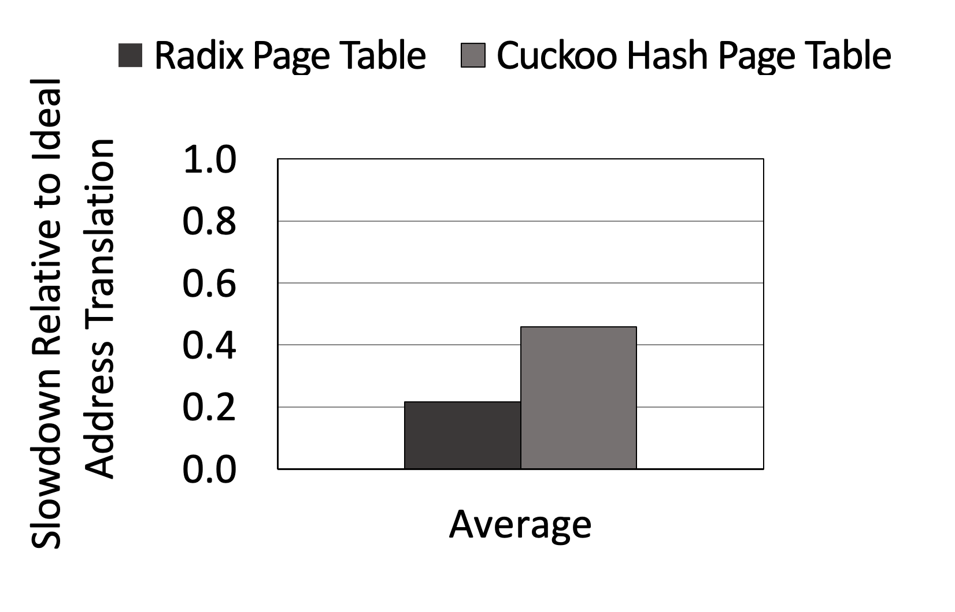
Overhead of Hash and Radix Translation in PIM
…
…
Notes:
* this graph shows the slowdown from each approach relative to an ideal address translation. *

Slide 49
Overhead of Hash and Radix Translation in PIM
Naïve integration of radix and cuckoo hash page table
cause significant slowdown in a PIM based system
…
…
Notes:
We can conclude that naïve integraton of radix and cuckoo hash table in PIM causes significant slowdown in a PIM based system.

Slide 50
Goal
Notes:
This brings us to our goal which is to

Slide 51
Goal
Design an efficient address translation
scheme for multi-stack PIM systems
Notes:
design an efficient address transltion scheme for multi-stacked PIM systems

Slide 52
Outline
Processing-in-Memory Introduction
Address Translation in PIM Architecture
Challenges and Key Ideas
Evaluation
Conclusion
Notes:
Now we will talk about the challenges and our proposed key ideas to achieve our goal

Slide 53
Challenge: Parallel lookups increase contention
Parallel lookups in cuckoo hash lead to increased memory network contention
S0
S3
S8
S11
S1
S2
S9
S10
Host CPU
Parallel Access 2
Parallel Access 1
S4
S7
S12
S15
S5
S6
S13
S14
TLB Miss at Stack 5
Notes:
Parallel lookups in cuckoo hash lead to increased memory network contention

Slide 54
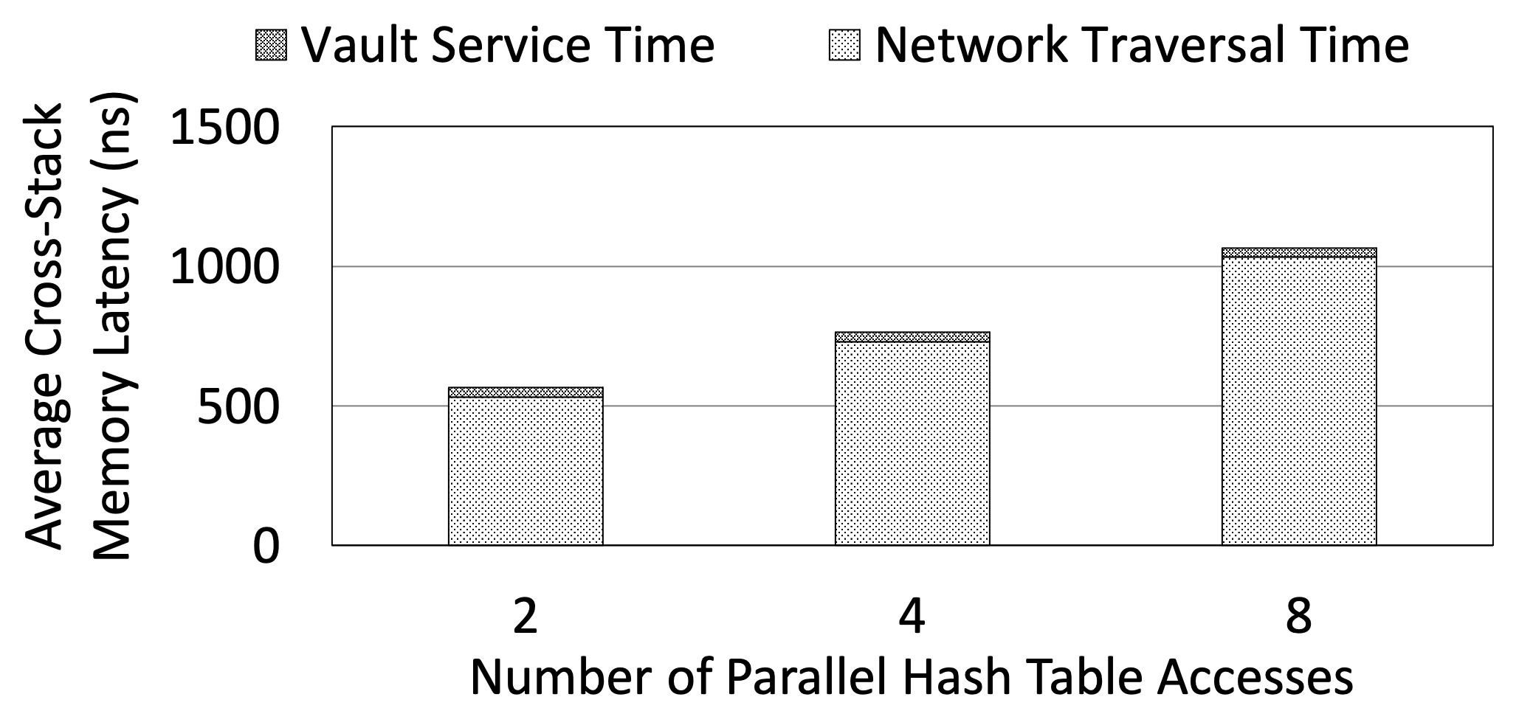
Challenge: Parallel lookups increase contention
Parallel lookups in cuckoo hash lead to increased memory network contention
S0
S3
S8
S11
S1
S2
S9
S10
Host CPU
Parallel Access 2
Parallel Access 1
S4
S7
S12
S15
S5
S6
S13
S14
TLB Miss at Stack 5
Notes:
The graph on the right shows average cross stack memory latency on the y axis and number of parallel accesses on the x axis. We can see that the average memory access latency is dominated by The network traversal time

Slide 55
Challenge: Parallel lookups increase contention
Parallel lookups in cuckoo hash lead to increased memory network contention
S0
S3
S8
S11
S1
S2
S9
S10
Host CPU
Parallel Access 2
Parallel Access 1
S4
S7
S12
S15
S5
S6
S13
S14
TLB Miss at Stack 5
Notes:
And increases with the number of parallel accesses issued the hash table

Slide 56
Challenge: Parallel lookups increase contention
Parallel lookups in cuckoo hash lead to increased memory network contention
S0
S3
S8
S11
S1
S2
S9
S10
Host CPU
Parallel Access 2
Parallel Access 1
S4
S7
S12
S15
S5
S6
S13
S14
TLB Miss at Stack 5
Cross-stack memory access latency
increase with parallel accesses
Notes:
So we can say that the average cross-stack memory access latency increase wit the number of parallel accesses

Slide 57
Observation: Massive parallelism inside stack
S0
S3
S8
S11
S1
S2
S9
S10
Host CPU
S4
S7
S12
S15
S5
S6
S13
S14
Notes:
To counter that challenge we make our first observation of

Slide 58
Observation: Massive parallelism inside stack
We observe immense intra-stack parallelism for parallel accesses
S0
S3
S8
S11
S1
S2
S9
S10
Host CPU
S4
S7
S12
S15
S5
S6
S13
S14
Notes:
massive parallelism inside each stack

Slide 59
Observation: Massive parallelism inside stack
We observe immense intra-stack parallelism for parallel accesses
S0
S3
S8
S11
Vault 0
Vault 1
Vault 2
Vault 31
S1
S2
S9
S10
Hash Table
Hash Table
Hash Table
Hash Table
…
Host CPU
Vault Logic
Vault Logic
Vault Logic
Vault Logic
S4
S7
S12
S15
Core 0
Core 1
Core 2
Core 31
S5
S6
S13
S14
Notes:
Each stack has multiple vaults

Slide 60
Observation: Massive parallelism inside stack
We observe immense intra-stack parallelism for parallel accesses
S0
S3
S8
S11
Vault 0
Vault 1
Vault 2
Vault 31
S1
S2
S9
S10
Hash Table
Hash Table
Hash Table
Hash Table
…
Host CPU
Vault Logic
Vault Logic
Vault Logic
Vault Logic
S4
S7
S12
S15
Core 0
Core 1
Core 2
Core 31
S5
S6
S13
S14
Notes:
Which can be used to trigger parallel accesses

Slide 61
Observation: Massive parallelism inside stack
We observe immense intra-stack parallelism for parallel accesses
S0
S3
S8
S11
Vault 0
Vault 1
Vault 2
Vault 31
S1
S2
S9
S10
Hash Table
Hash Table
Hash Table
Hash Table
…
Host CPU
Vault Logic
Vault Logic
Vault Logic
Vault Logic
S4
S7
S12
S15
Core 0
Core 1
Core 2
Core 31
S5
S6
S13
S14
Network traversal can be avoided if parallel accesses are
generated within the same stack and across different vaults
Notes:
So we ask the question whether we can utilize the intra stack parallelism to generate parallel inside the stack to avoid expensive network traversal

Slide 62
Key Idea: Network-contention-aware hash
Parallel lookups generated within the stack avoid costly cross-stack page table walks
S11
Notes:
This brings us to our first key idea of network contention aware hash where parallel accesses are generated inside each stack

Slide 63
Key Idea: Network-contention-aware hash
Parallel lookups generated within the stack avoid costly cross-stack page table walks
S0
S3
S8
S11
S1
S2
S9
S10
Host CPU
S4
S7
S12
S15
S5
S6
S13
S14
TLB Miss at Stack 5
S11
Notes:
On a TLB miss

Slide 64
Key Idea: Network-contention-aware hash
Parallel lookups generated within the stack avoid costly cross-stack page table walks
S0
S3
S8
S11
S1
S2
S9
S10
Host CPU
Only One Access Sent
S4
S7
S12
S15
S5
S6
S13
S14
TLB Miss at Stack 5
S11
Notes:
We only send one access across the network and on reaching the destination stack that request

Slide 65
Key Idea: Network-contention-aware hash
Parallel lookups generated within the stack avoid costly cross-stack page table walks
S0
S3
S8
S11
Vault 0
Vault 31
Hash Table
Hash Table
S1
S2
S9
S10
…
Vault Logic
Vault Logic
Host CPU
Only One Access Sent
Core 0
Core 31
Generation of Parallel Accesses
S4
S7
S12
S15
S5
S6
S13
S14
TLB Miss at Stack 5
S11
Notes:
Spawns parallel accesses inside the stack and across different vaults

Slide 66
Key Idea: Network-contention-aware hash
Parallel lookups generated within the stack avoid costly cross-stack page table walks
S0
S3
S8
S11
Vault 0
Vault 31
Hash Table
Hash Table
S1
S2
S9
S10
…
Vault Logic
Vault Logic
Host CPU
Only One Access Sent
Core 0
Core 31
Generation of Parallel Accesses
S4
S7
S12
S15
S5
S6
S13
S14
TLB Miss at Stack 5
S11
Network-contention-aware hash spawn parallel accesses
within the same stack to avoid network traversal
Notes:
This way of parallel access generation ensures that we avoid expensive network traversal and reduce the network contention

Slide 67
Benefit and Opportunity
Vault Time
Network Time
S0
S3
S8
S11
Parallel Access 1
V
N
Parallel Access 2
V
N
Timeline
S1
S2
S9
S10
Cuckoo hash
Host CPU
Parallel Access 2
Parallel Access 1
S4
S7
S12
S15
S5
S6
S13
S14
TLB Miss at Stack 5
Notes:
Now we will talk about the benefits and opportunities after the application of out first key idea. We had our baseline cuckoo hash which generated parallel accesses across the NETWORK leading to increased network contention.

Slide 68
Benefit and Opportunity
Vault Time
Network Time
S0
S3
S8
S11
Parallel Access 1
V
N
Parallel Access 2
V
N
Timeline
S1
S2
S9
S10
Cuckoo hash
Host CPU
Parallel Access 1
Parallel Access 1
V
N
Cycles Saved
S4
S7
S12
S15
Parallel Access 2
V
N
Timeline
Network contention-aware hash
S5
S6
S13
S14
TLB Miss at Stack 5
Notes:
On top of that, we proposed our network contention aware hash which spawned parallel accesses within the stack and reduced the network contention thus reducing the overall cross-stack memory access latency

Slide 69
Benefit and Opportunity
Vault Time
Network Time
S0
S3
S8
S11
Parallel Access 1
V
N
Parallel Access 2
V
N
Timeline
S1
S2
S9
S10
Cuckoo hash
Host CPU
Parallel Access 1
Parallel Access 1
V
N
Cycles Saved
S4
S7
S12
S15
Parallel Access 2
V
N
Timeline
Network contention-aware hash
S5
S6
S13
S14
Parallel Access 1
V
Opportunity
Parallel Access 2
V
Timeline
Opportunity to optimize
Can we get rid of this cross-stack access?
Notes:
After application of this , we still see that we are generating an access that is still traversing the network.

Slide 70
Benefit and Opportunity
Vault Time
Network Time
S0
S3
S8
S11
Parallel Access 1
V
N
Parallel Access 2
V
N
Timeline
S1
S2
S9
S10
Cuckoo hash
Host CPU
Parallel Access 1
Parallel Access 1
V
N
Cycles Saved
S4
S7
S12
S15
Parallel Access 2
V
N
Timeline
Network contention-aware hash
S5
S6
S13
S14
Parallel Access 1
V
Opportunity
Parallel Access 2
V
Timeline
Opportunity to optimize
Can we get rid of this cross-stack access?
Is there any way to eliminate the overhead of cross-stack access?
Notes:
So we ask the question, whether we can get rid of this cross-stack access and eliminate the overhead of cross-stack accesses further

Slide 71
Observation: PIM programs feature high parallelism
PIM suitable programs manifest as independent threads that can be assigned to different cores and execute in parallel
Vault 0
Vault 29
S0
S3
S8
S11
Hash Table
Hash Table
#pragma omp parallel for
for(...)
{
…
}
…
Vault Logic
Vault Logic
S1
S2
S9
S10
Core 0
Core 29
Host CPU
Vault 30
Vault 31
S4
S7
S12
S15
Hash Table
Hash Table
S5
S6
S13
S14
Vault Logic
Vault Logic
Core 30
Core 31
Notes:
To answer that question, we make another observation i.e. that PIM programs feature high parallelism

Slide 72
Observation: PIM programs feature high parallelism
PIM suitable programs manifest as independent threads that can be assigned to different cores and execute in parallel
Iterations are evenly distributed
across the PIM stacks for computation
Vault 0
Vault 29
S0
S3
S8
S11
Hash Table
Hash Table
#pragma omp parallel for
for(...)
{
…
}
…
Vault Logic
Vault Logic
S1
S2
S9
S10
Core 0
Core 29
Host CPU
Vault 30
Vault 31
S4
S7
S12
S15
Hash Table
Hash Table
S5
S6
S13
S14
Vault Logic
Vault Logic
Core 30
Core 31
Notes:
PIM suitable programs manifest as independent threads that can be assigned across different stacks

Slide 73
Observation: PIM programs feature high parallelism
PIM suitable programs manifest as independent threads that can be assigned to different cores and execute in parallel
Iterations are further distributed
across the vaults within a stack
Iterations are evenly distributed
across the PIM stacks for computation
Vault 0
Vault 29
S0
S3
S8
S11
Hash Table
Hash Table
#pragma omp parallel for
for(...)
{
…
}
…
Vault Logic
Vault Logic
S1
S2
S9
S10
Core 0
Core 29
Host CPU
Vault 30
Vault 31
S4
S7
S12
S15
Hash Table
Hash Table
S5
S6
S13
S14
Vault Logic
Vault Logic
Core 30
Core 31
Notes:
And further within the stack and across different vaults to be executed in parallel

Slide 74
Observation: Fewer cores cause minimal slowdown
Reduction in throughput has minimal impact on performance
Vault 0
Vault 29
S0
S3
S8
S11
Hash Table
Hash Table
#pragma omp parallel for
for(...)
{
…
}
…
Vault Logic
Vault Logic
S1
S2
S9
S10
Core 0
Core 29
Host CPU
Vault 30
Vault 31
S4
S7
S12
S15
Hash Table
Hash Table
S5
S6
S13
S14
Vault Logic
Vault Logic
Core 30
Core 31
Notes:
On top of that we make another observation that reducing throughout has minimal impact on performance

Slide 75
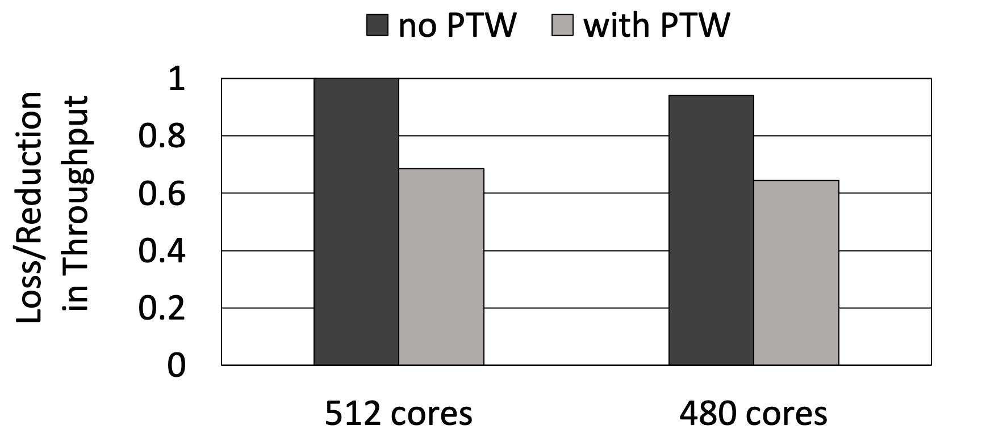
Page table walk overhead
Observation: PIM suitable programs feature high parallelism and manifest as independent loops that can be assigned to different cores and be executed in parallel
Observation: Reduction in throughput has minimal impact on performance
Notes:
To solidify our observation, we show this graph. This graph shows the reduction in performance as we reduce the number of cores from 512 to 480

Slide 76
Page table walk overhead
Observation: PIM suitable programs feature high parallelism and manifest as independent loops that can be assigned to different cores and be executed in parallel
Observation: Reduction in throughput has minimal impact on performance
Notes:
We see that there is very slight reduction in performance as we reduce the number of cores from 512 to 480

Slide 77
Page table walk overhead
Observation: PIM suitable programs feature high parallelism and manifest as independent loops that can be assigned to different cores and be executed in parallel
Observation: Reduction in throughput has minimal impact on performance
Performance is bottlenecked by the page table walk overhead
Notes:
However, we do see the performance gains that are possible by keeping the same reduced number of cores but elimination the page table walk overhead . This shows that the performance is bottlenecked by the page table walk overhead

Slide 78
Key Idea: Pre-translation of page table walks
Utilize some throughput to pre-translate page table walks
#pragma omp parallel for
for(...)
{
x=array1[i]
sum+=x
}
for(...)
{
x=array1[i]
sum+=x
}
Vault 0
Vault 29
S0
S3
S8
S11
Hash Table
Hash Table
Code for main cores
…
Vault Logic
Vault Logic
S1
S2
S9
S10
Core 0
Core 29
Host CPU
Vault 30
Vault 31
S4
S7
S12
S15
Code for pre-translation cores
Hash Table
Hash Table
S5
S6
S13
S14
Vault Logic
Vault Logic
Core 30
Core 31
Notes:
Based on these observations we propose our key idea of pre-translation of page table walks. In this key idea we propose to

Slide 79
Key Idea: Pre-translation of page table walks
Utilize some throughput to pre-translate page table walks
Main Cores
#pragma omp parallel for
for(...)
{
x=array1[i]
sum+=x
}
for(...)
{
x=array1[i]
sum+=x
}
Vault 0
Vault 29
S0
S3
S8
S11
Hash Table
Hash Table
Code for main cores
…
Vault Logic
Vault Logic
S1
S2
S9
S10
Core 0
Core 29
Host CPU
Pre-Translation Cores
Vault 30
Vault 31
S4
S7
S12
S15
Code for pre-translation cores
Hash Table
Hash Table
S5
S6
S13
S14
Vault Logic
Vault Logic
Core 30
Core 31
Notes:
Utilize some throughput to pre-translate page table walks. So in each stack we assign a fraction of the cores are pre-translation cores and the remaining cores remain the main cores performing the main computations.

Slide 80
Key Idea: Pre-translation of page table walks
Utilize some throughput to pre-translate page table walks
Main Cores
#pragma omp parallel for
for(...)
{
x=array1[i]
sum+=x
}
for(...)
{
x=array1[i]
sum+=x
}
Vault 0
Vault 29
S0
S3
S8
S11
Hash Table
Hash Table
Code for main cores
…
Vault Logic
Vault Logic
S1
S2
S9
S10
Core 0
Core 29
Host CPU
Pre-Translation Cores
Vault 30
Vault 31
S4
S7
S12
S15
Code for pre-translation cores
Hash Table
Hash Table
S5
S6
S13
S14
Vault Logic
Vault Logic
Core 30
Core 31
Pre-translation cores run ahead iterations for the main cores
Notes:
The pre-translation cores run ahead iterations for the main cores.

Slide 81
Key Idea: Pre-translation of page table walks
Filter the pre-translation code to remove non-memory accesses and accesses to small data structures that are less likely to trigger PTW
Main Cores
#pragma omp parallel for
for(...)
{
x=array1[i]
sum+=x
}
for(...)
{
x=array1[i]
sum+=x
}
Vault 0
Vault 29
S0
S3
S8
S11
Hash Table
Hash Table
Code for main cores
…
Vault Logic
Vault Logic
S1
S2
S9
S10
Core 0
Core 29
Host CPU
Pre-Translation Cores
Vault 30
Vault 31
S4
S7
S12
S15
Code for pre-translation cores
Hash Table
Hash Table
S5
S6
S13
S14
Vault Logic
Vault Logic
Core 30
Core 31
Notes:
We further propose to filter

Slide 82
Key Idea: Pre-translation of page table walks
Filter the pre-translation code to remove non-memory accesses and accesses to small data structures that are less likely to trigger PTW
Main Cores
#pragma omp parallel for
for(...)
{
x=array1[i]
sum+=x
}
for(...)
{
x=array1[i]
}
Vault 0
Vault 29
S0
S3
S8
S11
Hash Table
Hash Table
Code for main cores
…
Vault Logic
Vault Logic
S1
S2
S9
S10
Core 0
Core 29
Host CPU
Pre-Translation Cores
Vault 30
Vault 31
S4
S7
S12
S15
Code for pre-translation cores
Hash Table
Hash Table
S5
S6
S13
S14
Vault Logic
Vault Logic
Core 30
Core 31
Notes:
the pre-translation core’s code to ensure that they always run faster and ahead of the main cores

Slide 83
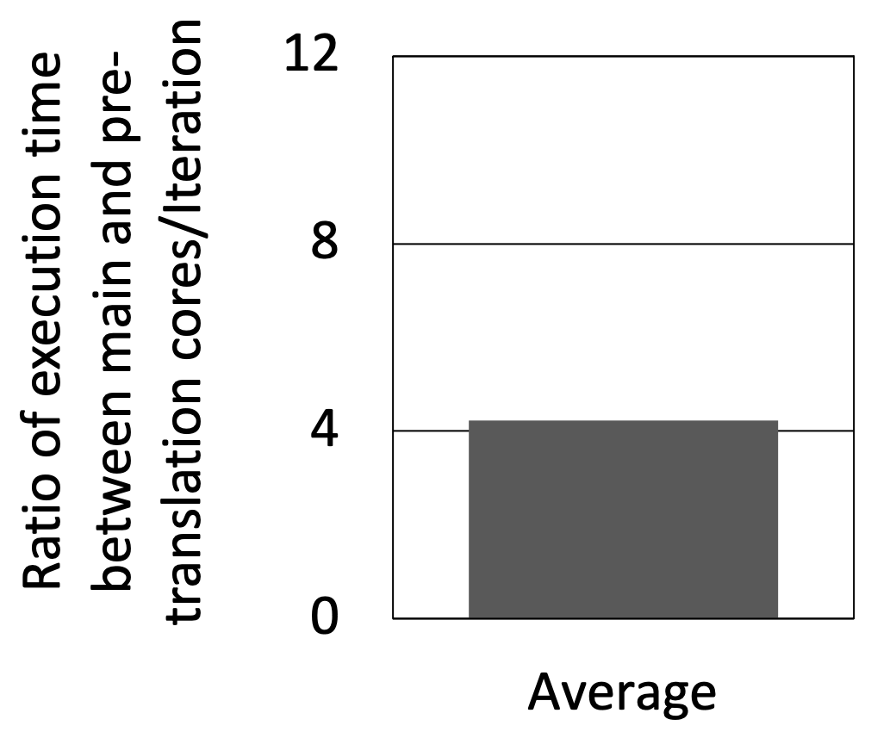
Key Idea: Pre-translation of page table walks
Filter the pre-translation code to remove non-memory accesses and accesses to small data structures that are less likely to trigger PTW
#pragma omp parallel for
for(...)
{
x=array1[i]
sum+=x
}
for(...)
{
x=array1[i]
}
S0
S3
S8
S11
Code for main cores
S1
S2
S9
S10
Host CPU
S4
S7
S12
S15
Code for pre-translation cores
S5
S6
S13
S14
Pre-translation cores run faster than the main cores and
are able to help a larger fraction of the main cores
Notes:
The graph on the extreme right shows the ratio of execution time between main and pre-translation cores per iteraton IT SHOWS THAT THE PRE-TRANSLATION CORES RUN AN ITERATION ON AVERAGE 4.2 times faster than the main cores. This also provides an opportunity for the pre-translation cores to help a relatively larger fraction of the main cores within the same stack.

Slide 84
Key Idea: Pre-translation of page table walks
Main Cores
#pragma omp parallel for
for(...)
{
x=array1[i]
sum+=x
}
for(...)
{
x=array1[i]
}
Vault 0
Vault 29
S0
S3
S8
S11
Hash Table
Hash Table
Code for main cores
…
Vault Logic
Vault Logic
S1
S2
S9
S10
Core 0
Core 29
Host CPU
Pre-Translation Cores
Vault 30
Vault 31
S4
S7
S12
S15
Code for pre-translation cores
Hash Table
Hash Table
S5
S6
S13
S14
Vault Logic
Vault Logic
Core 30
Core 31
Notes:
To better understand our key idea, lets do a walk through example

Slide 85
Key Idea: Pre-translation of page table walks
Step 1
Timeline
Main Cores
#pragma omp parallel for
for(...)
{
x=array1[i]
sum+=x
}
for(...)
{
x=array1[i]
}
Vault 0
Vault 29
S0
S3
S8
S11
Hash Table
Hash Table
Code for main cores
…
Vault Logic
Vault Logic
S1
S2
S9
S10
Core 0
Core 29
Host CPU
Pre-Translation Cores
Vault 30
Vault 31
S4
S7
S12
S15
Code for pre-translation cores
Hash Table
Hash Table
S5
S6
S13
S14
Vault Logic
Vault Logic
Core 30
Core 31
Notes:
During step 1, as the pre-translation cores are running ahead of the main cores

Slide 86

Key Idea: Pre-translation of page table walks
Step 1
Timeline
Main Cores
#pragma omp parallel for
for(...)
{
x=array1[i]
sum+=x
}
for(...)
{
x=array1[i]
}
Vault 0
Vault 29
// ITERATION u =0
Hash Table
Hash Table
S0
S3
S8
S11
Code for main cores
…
Vault Logic
Vault Logic
S1
S2
S9
S10
Core 0
Core 29
Host CPU
Pre-Translation Cores
// ITERATION u=10
Vault 30
Vault 31
S4
S7
S12
S15
Code for pre-translation cores
Hash Table
Hash Table
S5
S6
S13
S14
Vault Logic
Vault Logic
Core 30
Core 31
u=10
Notes:
, it starts the iteration at u=10 .

Slide 87
Key Idea: Pre-translation of page table walks
Step 1
Timeline
Main Cores
#pragma omp parallel for
for(...)
{
x=array1[i]
sum+=x
}
for(...)
{
x=array1[i]
}
Vault 0
Vault 29
// ITERATION u =0
Hash Table
Hash Table
S0
S3
S8
S11
Code for main cores
…
Vault Logic
Vault Logic
S1
S2
S9
S10
Core 0
Core 29
Host CPU
Pre-Translation Cores
// ITERATION u=10
Vault 30
Vault 31
S4
S7
S12
S15
Code for pre-translation cores
Hash Table
Hash Table
TLB Miss
Generated
S5
S6
S13
S14
Vault Logic
Vault Logic
Core 30
Core 31
u=10
Notes:
On executing the code within the iteration, the pre-translation core encounters a TLB miss

Slide 88
Key Idea: Pre-translation of page table walks
Step 1
Timeline
Main Cores
#pragma omp parallel for
for(...)
{
x=array1[i]
sum+=x
}
for(...)
{
x=array1[i]
}
Vault 0
Vault 29
// ITERATION u =0
Hash Table
Hash Table
S0
S3
S8
S11
Code for main cores
…
Vault Logic
Vault Logic
S1
S2
S9
S10
Core 0
Core 29
Host CPU
Pre-Translation Cores
// ITERATION u=10
Vault 30
Vault 31
S4
S7
S12
S15
Code for pre-translation cores
Hash Table
Hash Table
TLB Miss
Generated
S5
S6
S13
S14
Vault Logic
Vault Logic
Core 30
Core 31
Perform PTW
u=10
Notes:
To service the TLB miss, the pre-translation core performs a page table walk to get the translated address

Slide 89
Key Idea: Pre-translation of page table walks
Step 1
Timeline
Main Cores
#pragma omp parallel for
for(...)
{
x=array1[i]
sum+=x
}
for(...)
{
x=array1[i]
}
Vault 0
Vault 29
// ITERATION u =0
Hash Table
Hash Table
S0
S3
S8
S11
Code for main cores
…
Vault Logic
Vault Logic
S1
S2
S9
S10
Core 0
Core 29
Host CPU
Pre-Translation Cores
// ITERATION u=10
Vault 30
Vault 31
S4
S7
S12
S15
PB
Put translated address in PB
Hash Table
Hash Table
Code for pre-translation cores
TLB Miss
Generated
S5
S6
S13
S14
Vault Logic
Vault Logic
Core 30
Core 31
Perform PTW
u=10
PB
Pre-Translation Buffer
Notes:
After the page table walk is serviced, the pre-translation core stores the translation results in a pre-translation buffer located within the same stack in the pre-translation vault. This marks the end of step 1

Slide 90
Key Idea: Pre-translation of page table walks
Step 1
Step 2
Timeline
Main Cores
#pragma omp parallel for
for(...)
{
x=array1[i]
sum+=x
}
for(...)
{
x=array1[i]
}
Vault 0
Vault 29
S0
S3
S8
S11
Hash Table
Hash Table
Code for main cores
…
Vault Logic
Vault Logic
S1
S2
S9
S10
Core 0
Core 29
Host CPU
Pre-Translation Cores
Vault 30
Vault 31
S4
S7
S12
S15
PB
Code for pre-translation cores
Hash Table
Hash Table
S5
S6
S13
S14
Vault Logic
Vault Logic
Core 30
Core 31
PB
Pre-Translation Buffer
Notes:
Now, the step 2 starts

Slide 91
Key Idea: Pre-translation of page table walks
Step 1
Step 2
Timeline
Main Cores
#pragma omp parallel for
for(...)
{
x=array1[i]
sum+=x
}
for(...)
{
x=array1[i]
}
Vault 0
Vault 29
// ITERATION u =10
Hash Table
Hash Table
S0
S3
S8
S11
Code for main cores
…
Vault Logic
Vault Logic
S1
S2
S9
S10
Core 0
Core 29
Host CPU
u=10
Pre-Translation Cores
// ITERATION u=20
Vault 30
Vault 31
S4
S7
S12
S15
PB
Code for pre-translation cores
Hash Table
Hash Table
S5
S6
S13
S14
Vault Logic
Vault Logic
Core 30
Core 31
PB
Pre-Translation Buffer
Notes:
When the main core encounters the same iteration u=10 at a later point of execution

Slide 92
Key Idea: Pre-translation of page table walks
Step 1
Step 2
Timeline
Main Cores
#pragma omp parallel for
for(...)
{
x=array1[i]
sum+=x
}
for(...)
{
x=array1[i]
}
Vault 0
Vault 29
// ITERATION u =10
Hash Table
Hash Table
S0
S3
S8
S11
Code for main cores
…
TLB Miss
Generated
Vault Logic
Vault Logic
S1
S2
S9
S10
Core 0
Core 29
Host CPU
Pre-Translation Cores
// ITERATION u=20
Vault 30
Vault 31
S4
S7
S12
S15
PB
Code for pre-translation cores
Hash Table
Hash Table
S5
S6
S13
S14
Vault Logic
Vault Logic
Core 30
Core 31
PB
Pre-Translation Buffer
Notes:
On executing the code inside the iteration, the main core also generates a TLB miss for the same data.

Slide 93
Key Idea: Pre-translation of page table walks
Step 1
Step 2
Timeline
Main Cores
#pragma omp parallel for
for(...)
{
x=array1[i]
sum+=x
}
for(...)
{
x=array1[i]
}
Vault 0
Vault 29
// ITERATION u =10
Hash Table
Hash Table
S0
S3
S8
S11
Code for main cores
…
TLB Miss
Generated
Get translated address from PB
Vault Logic
Vault Logic
S1
S2
S9
S10
Core 0
Core 29
Host CPU
u=10
Pre-Translation Cores
// ITERATION u=20
Vault 30
Vault 31
S4
S7
S12
S15
PB
Code for pre-translation cores
Hash Table
Hash Table
S5
S6
S13
S14
Vault Logic
Vault Logic
Core 30
Core 31
PB
Pre-Translation Buffer
Notes:
Now, instead of performing a page table walk, the main core consults the pre-translation buffer within the stack . Since the pre-translation core had already translated the required address and stored it in the pre-translation buffer, therefore the main core gets the pre-transalted results from the PB

Slide 94
Key Idea: Pre-translation of page table walks
Step 1
Step 2
Timeline
Main Cores
#pragma omp parallel for
for(...)
{
x=array1[i]
sum+=x
}
for(...)
{
x=array1[i]
}
Vault 0
Vault 29
// ITERATION u =10
Hash Table
Hash Table
S0
S3
S8
S11
Code for main cores
…
TLB Miss
Generated
Get translated address from PB
Vault Logic
Vault Logic
S1
S2
S9
S10
Core 0
Core 29
Host CPU
u=10
Pre-Translation Cores
// ITERATION u=20
Vault 30
Vault 31
S4
S7
S12
S15
PB
Code for pre-translation cores
Hash Table
Hash Table
S5
S6
S13
S14
Vault Logic
Vault Logic
Core 30
Core 31
Pre-translation moves the page table walk
latency off the critical path of execution
PB
Pre-Translation Buffer
Notes:
This concludes our final step 2 and we can see that Pre-translation moves the page table walk
latency off the critical path of execution

Slide 95
Summary of our approaches
Vault Time
Network Time
S0
S3
S8
S11
Parallel Access 1
V
N
Parallel Access 2
V
N
Timeline
S1
S2
S9
S10
Cuckoo hash
Host CPU
Parallel Access 2
Parallel Access 1
S4
S7
S12
S15
S5
S6
S13
S14
TLB Miss at Stack 5
Notes:
To summarize our approaches, we had our baseline cuckoo hash page table

Slide 96
Summary of our approaches
Vault Time
Network Time
S0
S3
S8
S11
Parallel Access 1
V
N
Parallel Access 2
V
N
Timeline
S1
S2
S9
S10
Cuckoo hash
Host CPU
Parallel Access 1
Parallel Access 1
V
N
Cycles Saved
S4
S7
S12
S15
Parallel Access 2
V
N
Timeline
Network contention-aware hash
S5
S6
S13
S14
Notes:
On top of what we proposed our network contention aware hash that reduced network contention and thus the overall cross-stack memory access time and helped us improve our performance.

Slide 97
Summary of our approaches
Vault Time
Network Time
S0
S3
S8
S11
Parallel Access 1
V
N
Parallel Access 2
V
N
Timeline
S1
S2
S9
S10
Cuckoo hash
Host CPU
Parallel Access 1
V
N
Cycles Saved
S4
S7
S12
S15
Parallel Access 2
V
N
Timeline
Network contention-aware hash
S5
S6
S13
S14
Total Cycles Saved
Access PB in stack
PB
Timeline
Network contention-aware hash
& pre-translation
Notes:
On top of that we propose our pre-translation which further reduce the network overhead by pre-translating ptw and bringing them inside the same stack for future use.

Slide 98
Outline
Processing-in-Memory Introduction
Address Translation in PIM Architecture
Challenges and Key Ideas
Evaluation
Conclusion
Notes:
Now, I will talk about our evaluation

Slide 99
Methodology
Simulation Infrastructure (MultiPIM)
Configuration for Simulated PIM stacks
Memory | Total number | 16
 | Memory interconnection | Dragonfly
 | Capacity per memory | 4GB, 4 layers, 8 banks per vault
 | Vaults per memory | 32, 32 TSV per vault
 | DRAM | FR-FCFS, tCL=tRCD=tRP=17ns, tCWL=13ns
PIM Core | Type | In-order, 1 issue @ 2000MHZ
 | L1I/D-Cache | Split 32KB, 4ways, 64B cacheline, LRU, write-back, MESI
 | I/D-TLB | Split 64 entries, LRU
 | Page table walker | 1
 | Pre-Translation Buffer Size | 1024 entries per stack
Notes:
To model our system, we use the MultiPIM simulator which is based on already verified simulations, ramulator and zsim. The network is modelled using bookism. We evaluate a total number of 16 stacks interconnected by a dragondfly topology. Each modelled stack has 32 vaults where each vault has a single core with a TLB with 64 entries and a page table walker. Each stack had a pre-translation buffer with 1024 enties.

Slide 100
Methodology
Workloads:
Gapbs benchmark suite with workloads:
bfs
tc
cc
Parboil benchmark suite using the largest available dataset
spmv
sgemm
stencil
mri-grid
mri-q
cc_sv
sssp
pr
histo
tpacf
cutcp
lbm
Notes:
We evaluate the workloads from the gapbs benchamark suite using the two real world input datasets twitter and Friendster. We also evaluate the workloads from parboil bechmakr with the largest available dataset

Slide 101
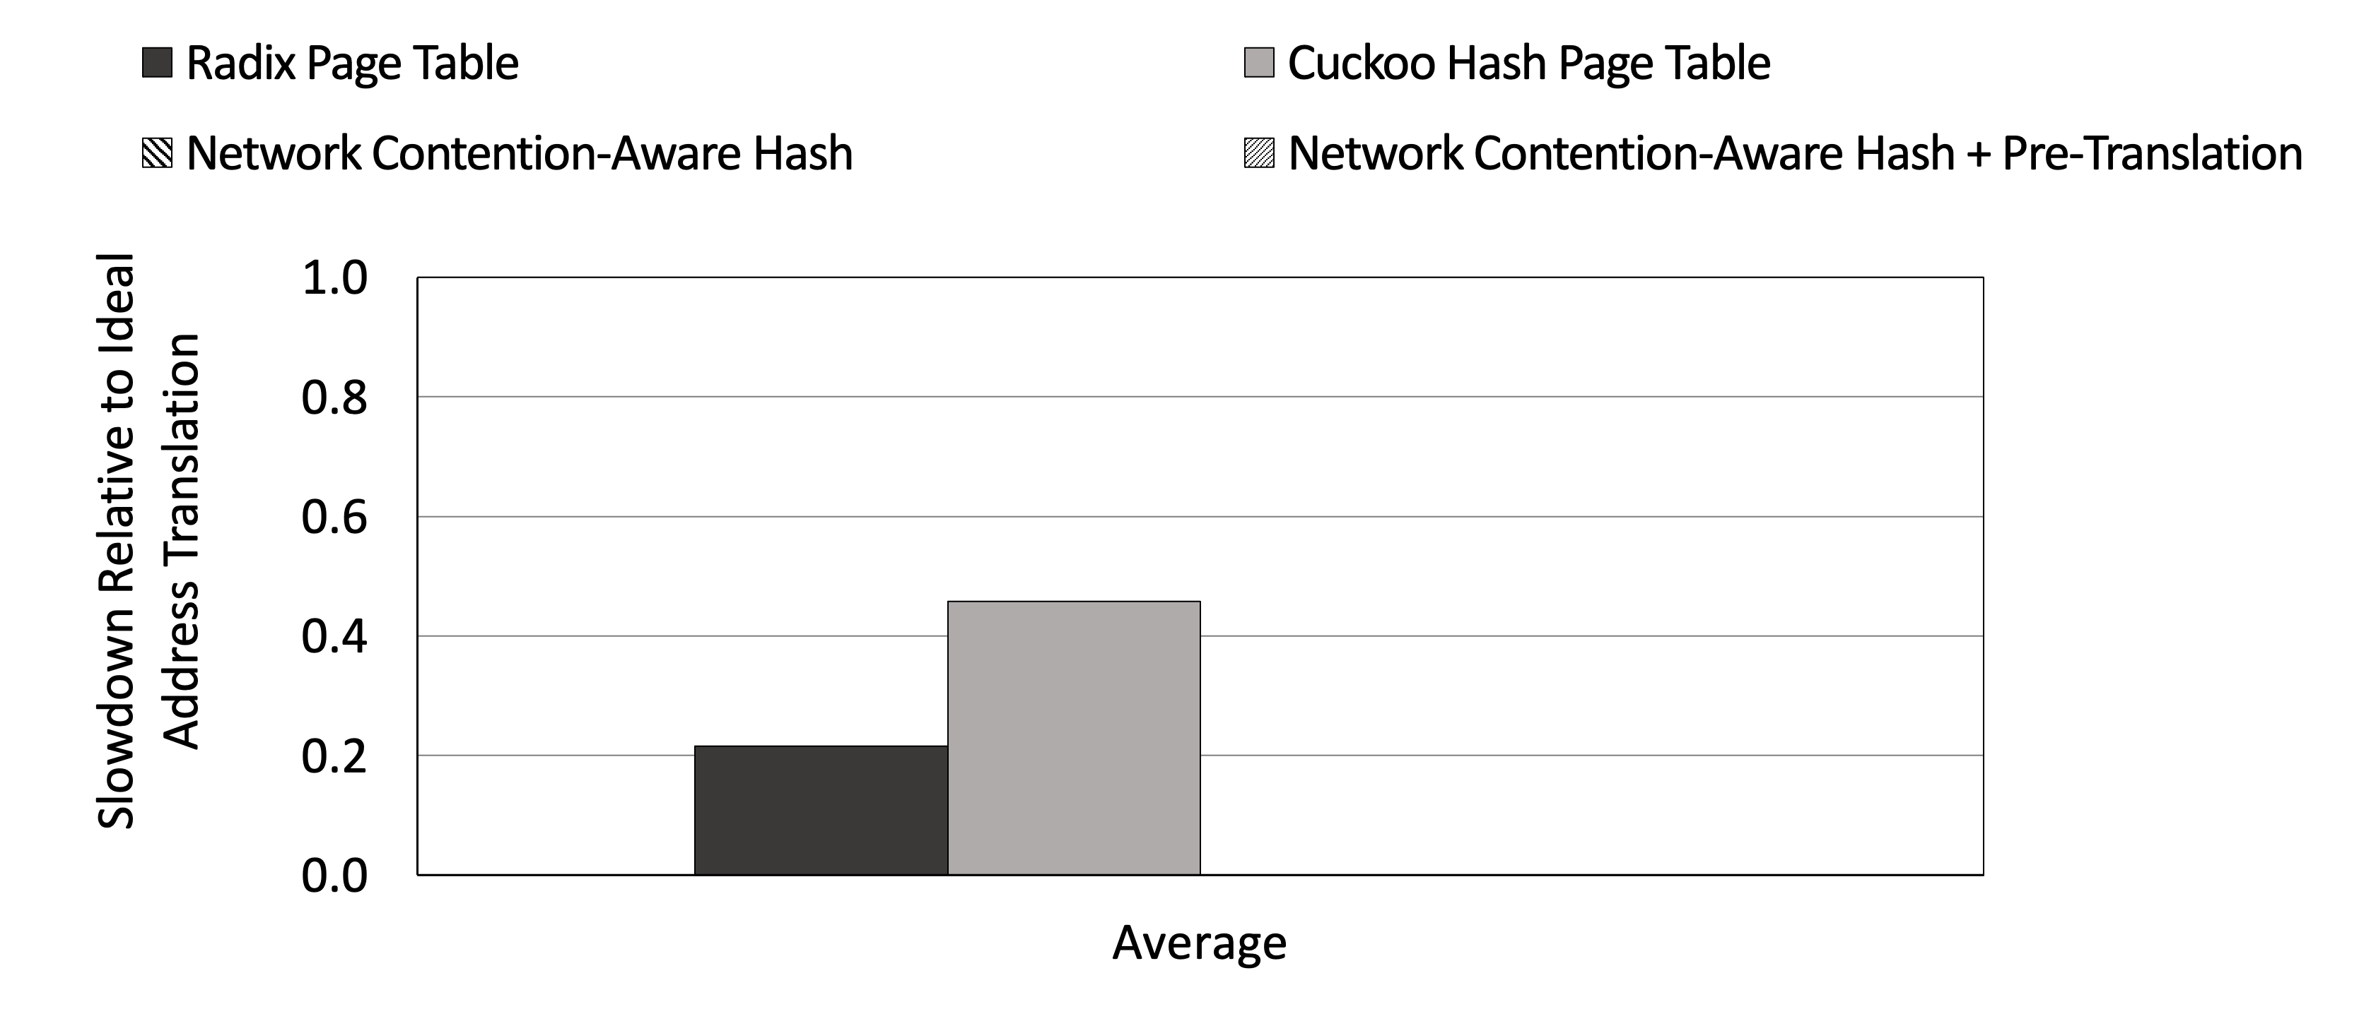
Performance Improvement
Notes:
Now talking about the performane improvement. Our Y axis shows the slowdown relative to an ideal address translation and is normalized to that. Our x axis shows the average number across all the evaluated workloads discussed before. We had our two baseline radix and cuckoo hash page table and we see that

Slide 102
Performance Improvement
Huge performance overhead with radix and hash page table in PIM
Notes:
Both of them suffer from significant performance overhead in a PIM system

Slide 103
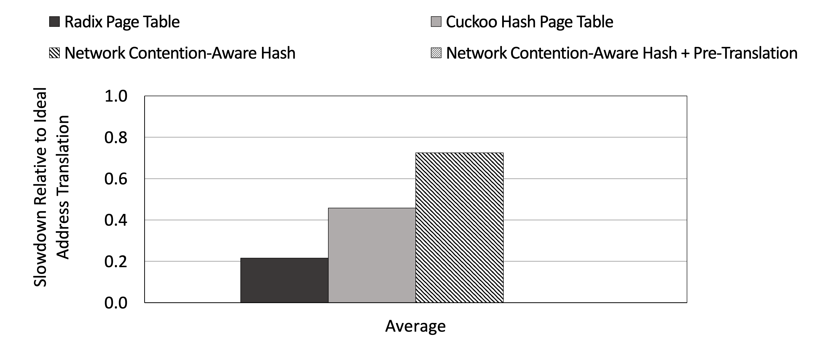
Performance Improvement
Notes:
Our network contention aware hash on top of that helper us

Slide 104
Performance Improvement
Network contention-aware hash achieves a speedup
of 3.97× and 1.6× compared to radix and cuckoo hash page table
Notes:
Achieve a speedup of 3.97 and 1.6x compared to radix and cuckoo hash page table.

Slide 105
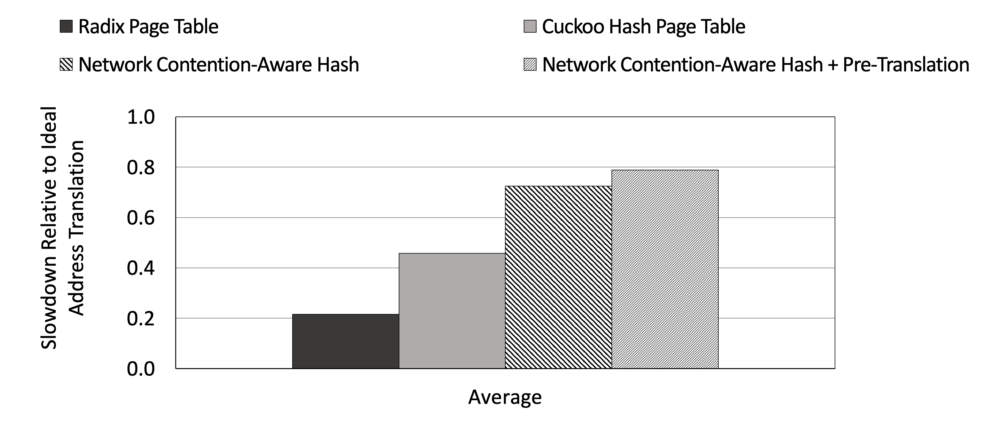
Performance Improvement
Notes:
On top of that we proposed our pre-translation mechanism which

Slide 106
Performance Improvement
A total speedup of 4.4× and 1.7× is achieved
compared to radix and cuckoo hash page table
Notes:
Gave us a total speedup of 4.4x and 1.7x compared to rasix and cuckoo has page table

Slide 107
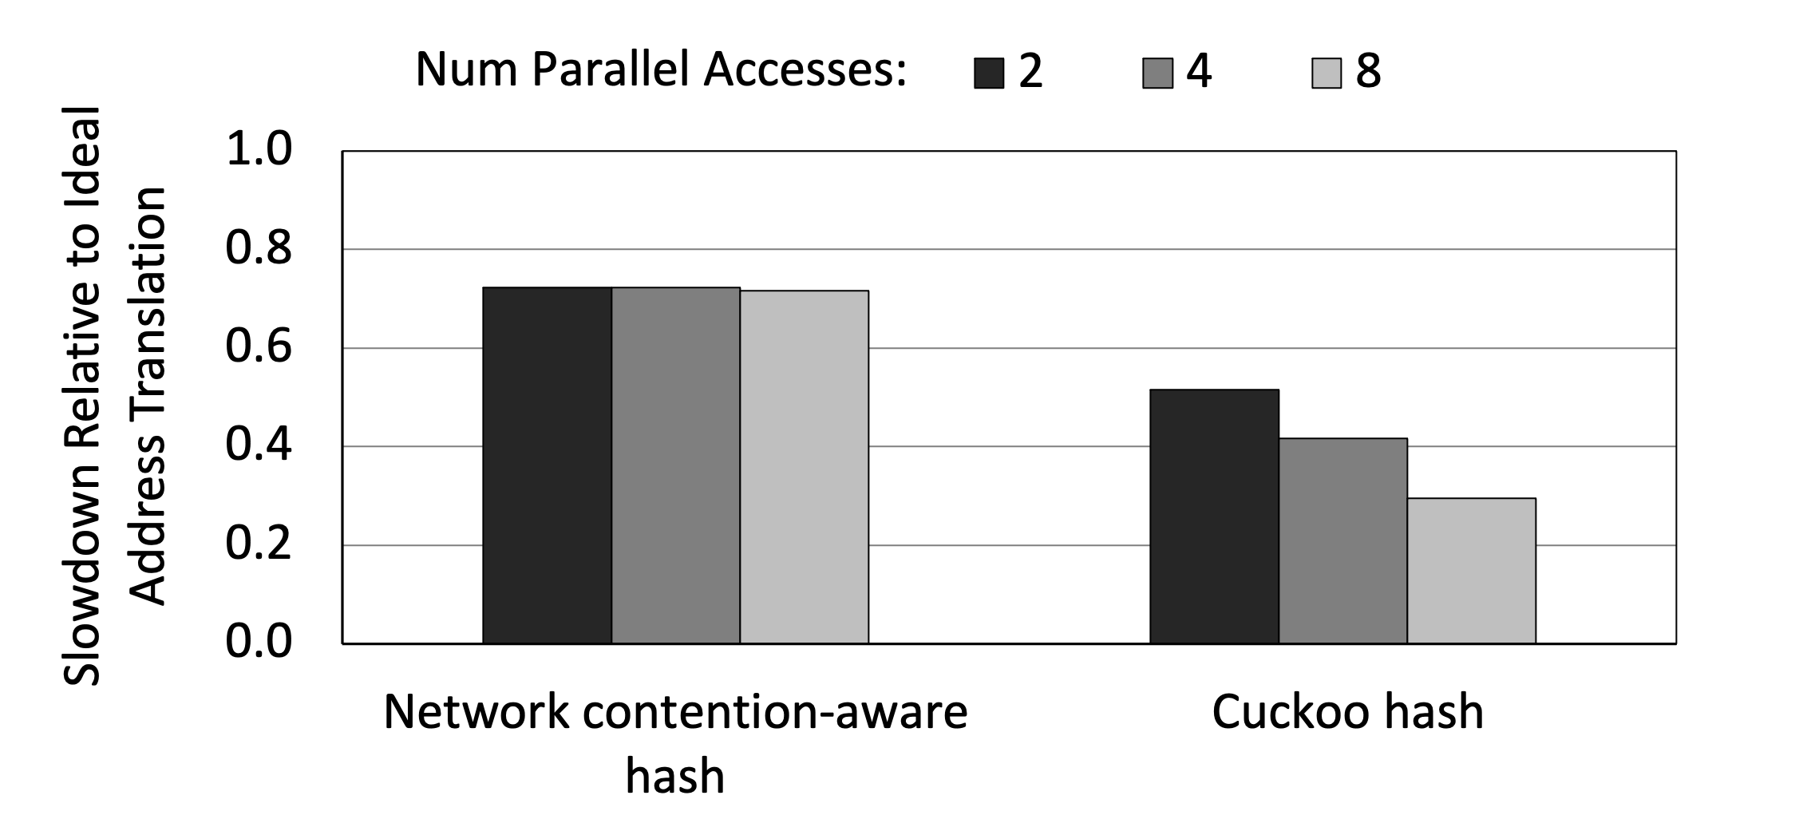
Sensitivity Results
Notes:
Now we will discuss some sensitivity results as we increase the number of parallel accesses from 2 to ,4 and 8 accesses.for both cuckoo hash and our network contention aware hash.

Slide 108
Sensitivity Results
Notes:
We see that our network contention aware hash scales pretty well with 2,4, and 8 accesses

Slide 109
Sensitivity Results
Network contention-aware hash scales well
with minor performance degradation
Notes:
Showing minimal network conention introduced and thus minimal performance degradation as we increase number of paralle accesses from 2 to 8 which is a result of generating parallel accesses within a stack instead of generating them across different stacks

Slide 110
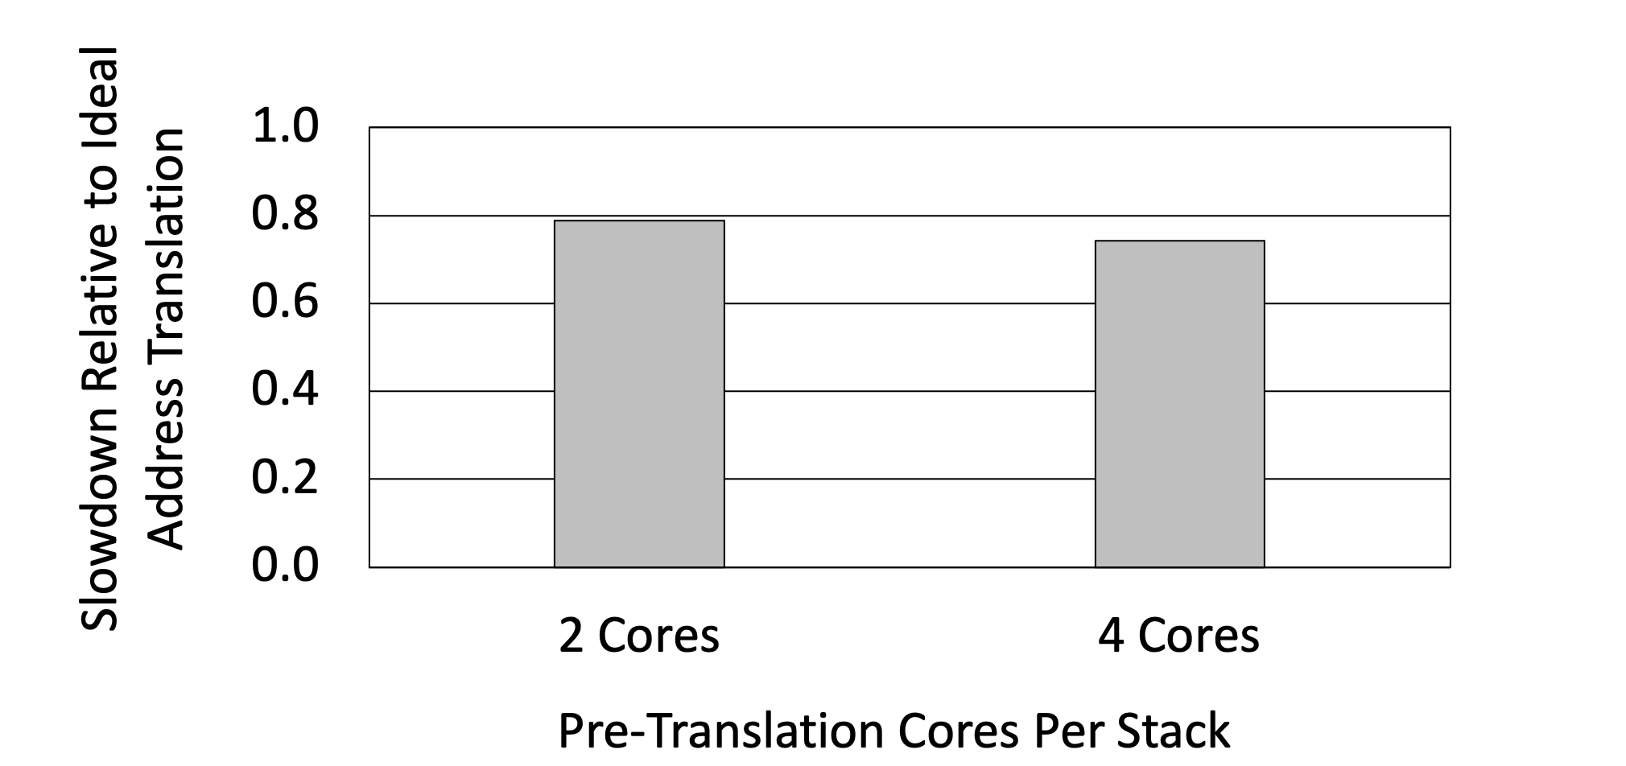
Sensitivity Results
Notes:
In addition to that we have our sensitivity results for 2 pre-translation cores and 4 pre-translation coeres epr stacks.

Slide 111
Sensitivity Results
2 cores is a good tradeoff between
performance loss and pre-translation
Notes:
We see that 2 pre-translation cores per stack is a good tradeoff between performance loss as a result of reduced number of cores for main computation and performance gain due to reduced page table walks overhead.

Slide 112
Outline
Processing-in-Memory Introduction
Address Translation in PIM Architecture
Challenges and Key Ideas
Evaluation
Conclusion
Notes:
Now I will conclude my talk.

Slide 113
Conclusion
Multiple (PIM) stacks provide increased capacity for emerging data-intensive workloads
Running generalized applications divided between CPU and PIM is highly important
We propose address translation for multi-stack PIM running same application in CPU & PIM
Key Ideas:
Network-contention-aware hash: Adapts cuckoo hash layout for multi-stack PIM system
Pre-translation: Pre-translates addresses to avoid cross-stack page table walk accesses
Result: Provides 4.4x and 1.7x speedup compared to radix and cuckoo hash
Notes:
.

